Slide 1

ALGORITHM
Done by:
Harish. B

Slide 2
Abstract
The importance of a Webpage is an inherently subjective matter, which depends on the readers interests, knowledge and attitudes. But there is still much that can be said objectively about the relative importance of Web pages. This paper describes PageRank, a method for rating Web pages objectively and mechanically, effectively measuring the human interest and attention devoted to them.
We compare PageRank to an idealized random Websurfer. We show how to efficiently compute PageRank for large numbers of pages. And we show how to apply PageRank to search and to user navigation.
Besides other ranking signals, Google uses PageRank algorithm in ranking the search results, which makes Google successful and superior to others.
Keywords: Google, Search Engine, PageRank, Markov chains, power method, damping factor, stationary vector, updating Result, Page Ranking.

Slide 3
Introduction
Ranking is the process of identifying most relevant resources with highest quality among all the relevant resources on the Web and any other information retrieval system.
Ranking algorithms help in ranking web pages in order to bring the most relevant web documents at the top of the SERP (Search Engine Results Page).
Among these ranking algorithms, PageRank is an evolutionary algorithm and a major breakthrough in the field of ranking. Since its inception in 1998, it is still at the heart of Google web search engine.
In this research we introduce a ranking procedure for networks generalizing Google's celebrated PageRank to reducible networks. The ranking method provided in this paper paves the way for developing control approaches for general networks.

Slide 4
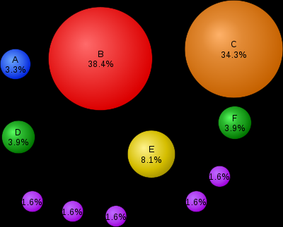
PAGE RANK
PageRank (PR) is an algorithm used by Google Search to rank web pages in their search engine results. PageRank is a way of measuring the importance of website pages. According to Google:
PageRank works by counting the number and quality of links to a page to determine a rough estimate of how important the website is. The underlying assumption is that more important websites are likely to receive more links from other websites.
PageRank is a system for ranking web pages that Google's founders Larry Page and Sergey Brin developed at Stanford University. And what it is important to understand is that PageRank is all about links.

Slide 5

Why it is so important?
Page rank is important because it’s one of the factors a search engine like Google takes into account when it decides which results to show at the top of its search engine listings – where they can be easily seen. (In fact, PageRank is a Google trademark – but other search engines use similar techniques.)
It’s not the only or even the most important factor. To start with, your page needs to be relevant to whatever the search is – if someone’s searching for plumbers, your page about online banking isn’t going to feature no matter how high its page rank may be. But all other things being equal, page rank does affect search engine rankings.

Slide 6

HISTORY
The big innovation of the late 1990s is the development of search engines, which began with Alta Vista at DEC’s Western Research Lab and reached its modern pinnacle with Google, founded by Stanford graduate students Larry Page and Sergey Brin in 1998.
The heart of the Google search engine is the PageRank algorithm, which was described in the paper you read for today’s class, written by Larry Page, Sergey Brin, Rajeev Motwani (who drowned in a tragic accident in 2009), and Terry Winograd.

Slide 7
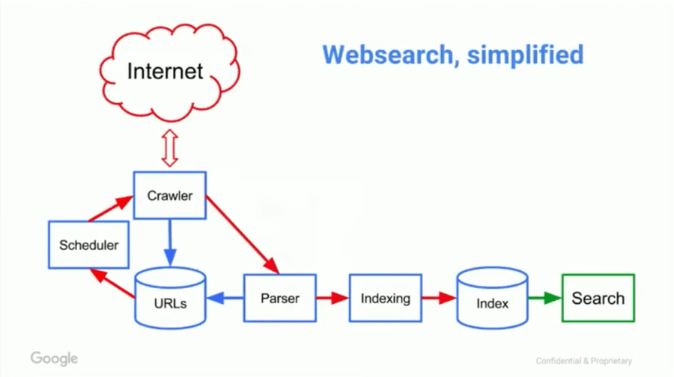
How Search Engine Works?
Search engines work by taking a list of known URLs, which then go to the scheduler. The scheduler decides when to crawl each URL. Crawled pages then go to the parser where vital information is extracted and indexed. Parsed links go to the scheduler, which prioritizes their crawling and re-crawling.
When you search for something, search engines return matching pages, and algorithms rank them by relevance.

Slide 8
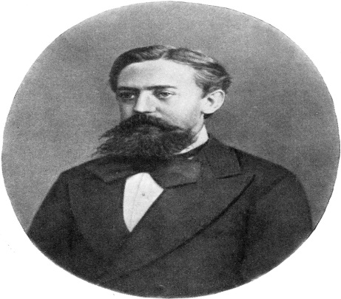
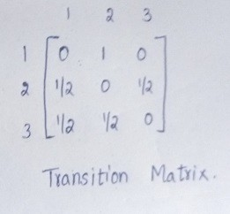
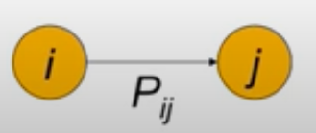
Markov chain
It is a stochastic model that describes the sequence of possible events in which the probability of each event depends only on the state attained in the previous event.
A countably infinite sequence, in which the chain moves state at discrete time steps, gives a discrete-time Markov chain. A continuous-time process is called a continuous-time Markov chain. It is named after the Russian mathematician Andrey Markov.

Slide 9
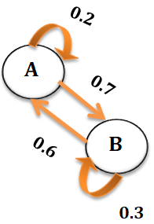
Markov chains has many applications such as statistical models of real-world processes, studying cruise control systems in motor vehicles, queues or lines of customers arriving at an airport, currency exchange rates, and animal population dynamics.
Google’s random surfer is an example of a Markov process, in which a system moves from state to state, based on probability information that shows the likelihood of moving from each state to every other possible state.

Slide 10
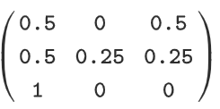
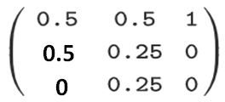
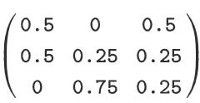
Stochastic Matrix
In mathematics, a stochastic matrix is a square matrix used to describe the transitions of a Markov chain. Each of its entries is a non-negative real number representing a probability. It is also called a probability matrix, transition matrix, substitution matrix, or Markov matrix.
A Right Stochastic Matrix is a real square matrix, with each row summing to 1.
A Left Stochastic Matrix is a real square matrix, with each column summing to 1.
A Doubly Stochastic Matrix is a square matrix of non-negative real numbers with each row and column summing to 1.

Slide 11
The PageRank Algorithm
• The PageRank algorithm gives each page a rating of its importance, which is a recursively defined measure whereby a page becomes important if important pages link to it. This definition is recursive because the importance of a page refers back to the importance of other pages that link to it.
• One way to think about PageRank is to imagine a random surfer on the web, following links from page to page. The page rank of any page is roughly the probability that the random surfer will land on a particular page. Since more links go to the important pages, the surfer is more likely to end up there.
• The behavior of the random surfer is an example of a Markov process, which is any random evolutionary process that depends only of the current state of a system and not on its history.

Slide 12
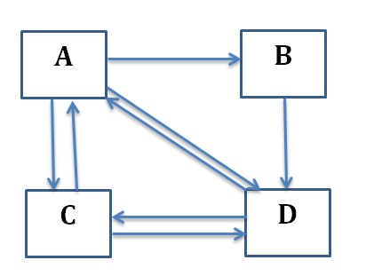
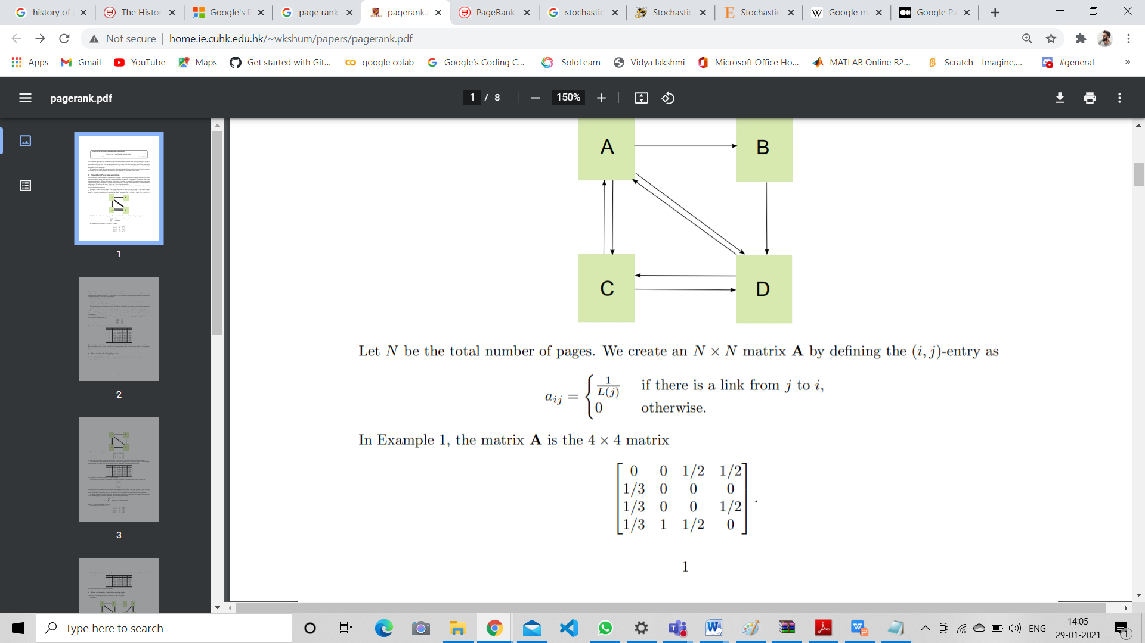
Simplified Pagerank Algorithm
The algorithm which results in the probability distribution used to represent the person clicking the links randomly will arrive at any page particularly. It has been calculated for the collections of documents of any size. The PageRank computations require several passes, called "Iterations", through the collection to adjust approximate PageRank values to more closely reflect the theoretical true value.

Slide 13
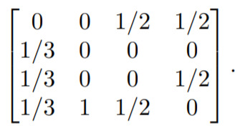
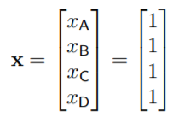
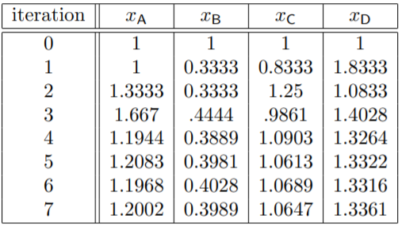
The matrix A is the 4 × 4 matrix:
We let the components of the vector x be x_{A}, x_{B}, x_{C} and x_{D}.
Initialize x to be the all-one column vector,
Evolution of the pagerank vector:

Slide 14

Calculating the Eigenvector ‘I’
Let us consider the power method for calculating the eigenvector. In this method, we begin by choosing a vector I⁽⁰⁾ = (1, 1, 1, . . . , 1)’ as a candidate for I and then produce a sequence of vectors I^{(k)} such that
I^{(k+1)} = H*I^{(k)}
There are issues regarding the convergence of the sequence of vectors I^{(n)}. Matrix under consideration must satisfy certain conditions.
For the web described in example,
where A = and let I⁽⁰⁾ = now, using the power method
I⁽¹⁾ = H*I⁽⁰⁾ , I⁽²⁾ = H*I⁽¹⁾ , I⁽³⁾ = H*I⁽²⁾ , I⁽⁴⁾ = H*I⁽³⁾ , ... , I^{(k+1)} = H*I^{(k)}

Slide 15
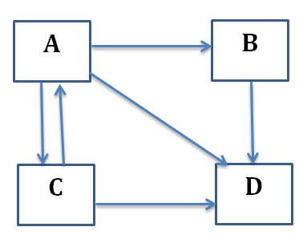
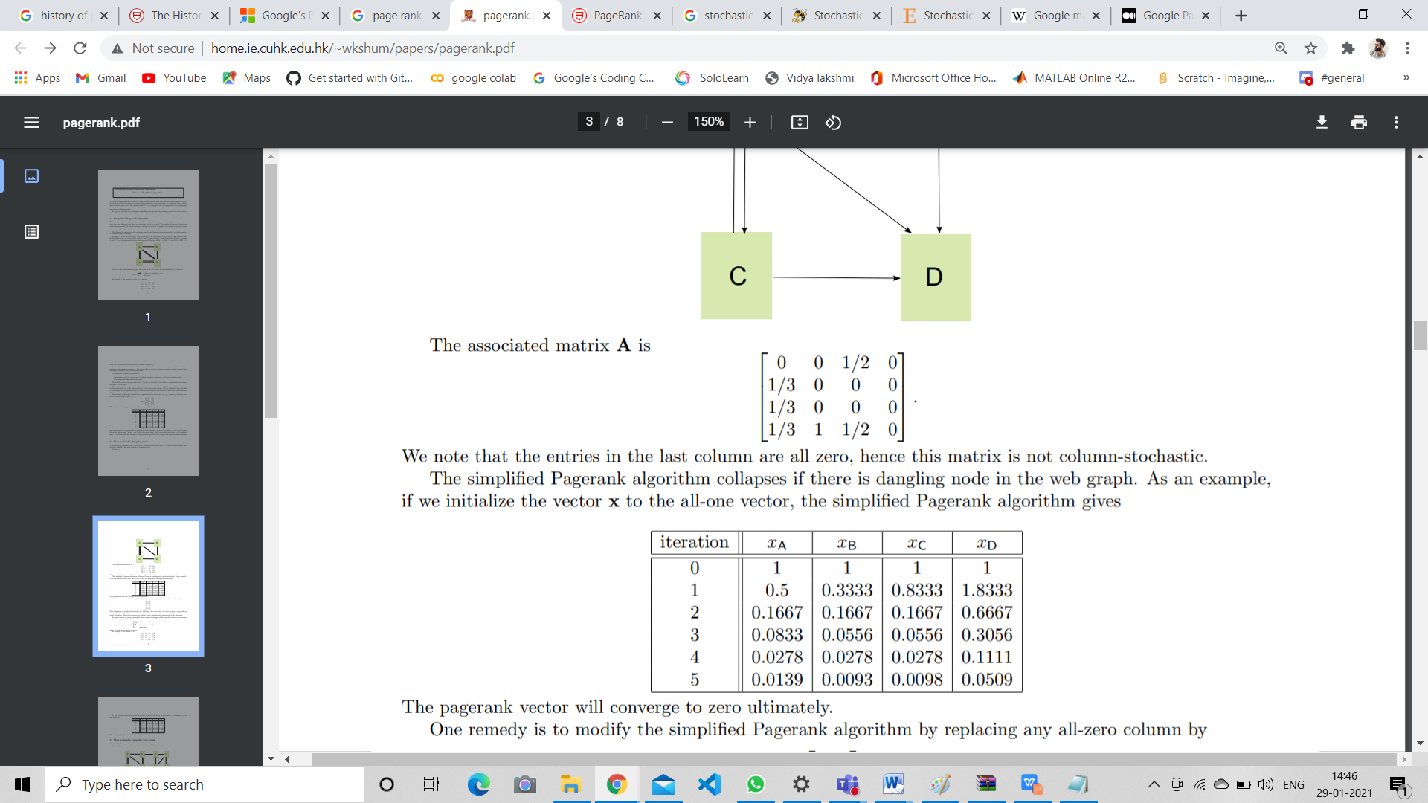
How to handle dangling node
Dangling Node: A node is called a dangling node if it does not contain any out-going link, if
the out-degree is zero.
The associated matrix A is:

Slide 16
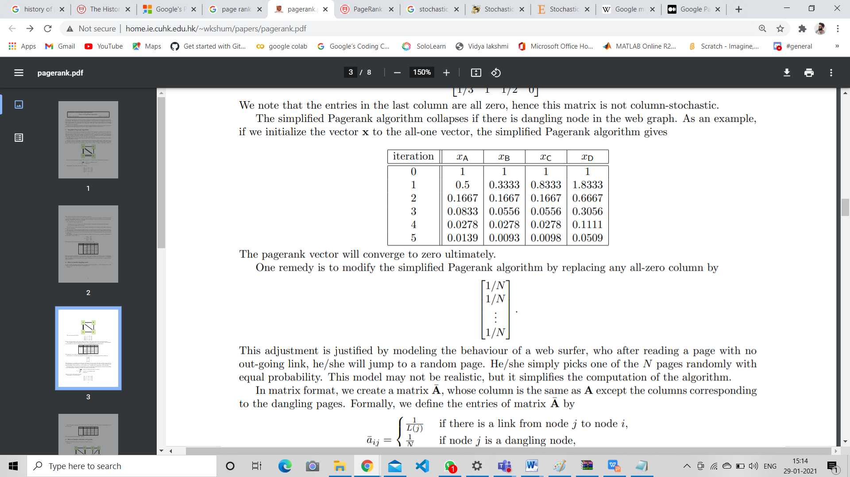
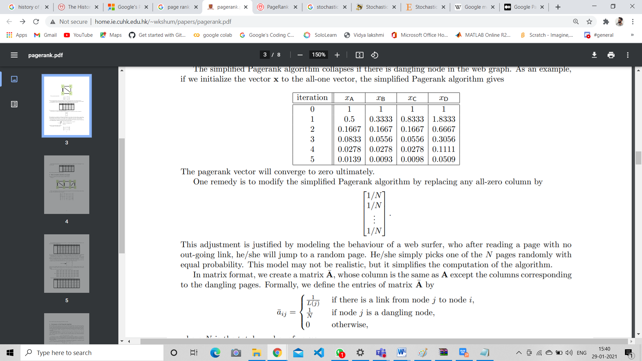
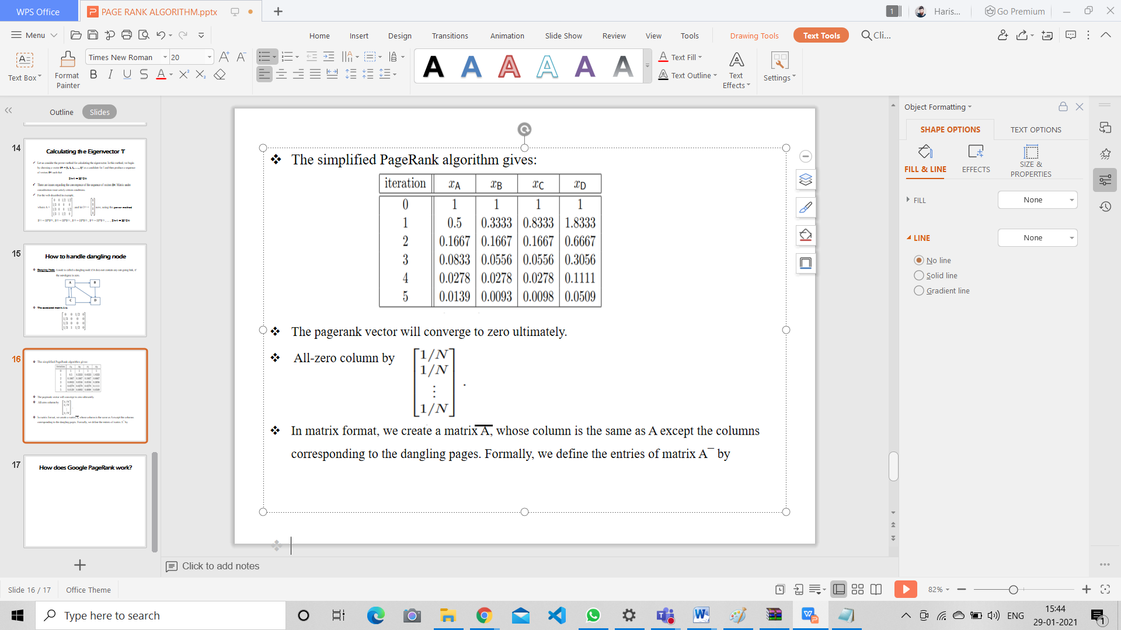
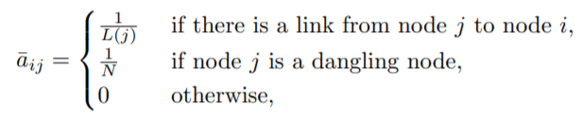
The simplified PageRank algorithm gives:
The pagerank vector will converge to zero ultimately.
All-zero column by
In matrix format, we create a matrix , whose column is the same as A except the columns corresponding to the dangling pages. Formally, we define the entries of matrix by
where N is the total number of pages.

Slide 17
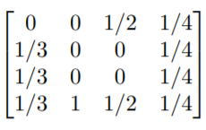
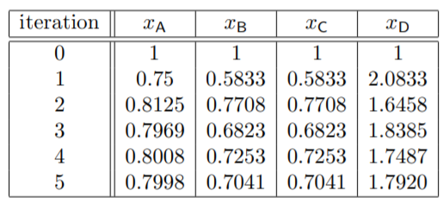
The matrix is:
if we use , we get
We see that page D has the highest ranking.

Slide 18
Assume another Example of four web pages A, B, C and D.
In the original form of PageRank, the sum of PageRank over all pages was the total number of pages on the web at that time, so each page in this example would have an initial value of 1.
However, later versions of PageRank, and the remainder of this section, assume a probability distribution between 0 and 1. Hence the initial value for each page in this example is 0.25.
If the only links in the system were from pages B, C, and D to A, each link would transfer 0.25 PageRank to A upon the next iteration, for a total of 0.75.
PR(A) = PR(B) + PR(C) + PR(D)
Suppose instead that page B had a link to pages C and A, page C had a link to page A, and page D had links to all three pages. Thus, upon the first iteration, page B would transfer half of its existing value, or 0.125, to page A and the other half, or 0.125, to page C.
Page C would transfer all of its existing value, 0.25, to the only page it links to, A. Since D had three outbound links, it would transfer one third of its existing value, or approximately 0.083, to A. At the completion of this iteration, page A will have a PageRank of approximately 0.458.

Slide 19


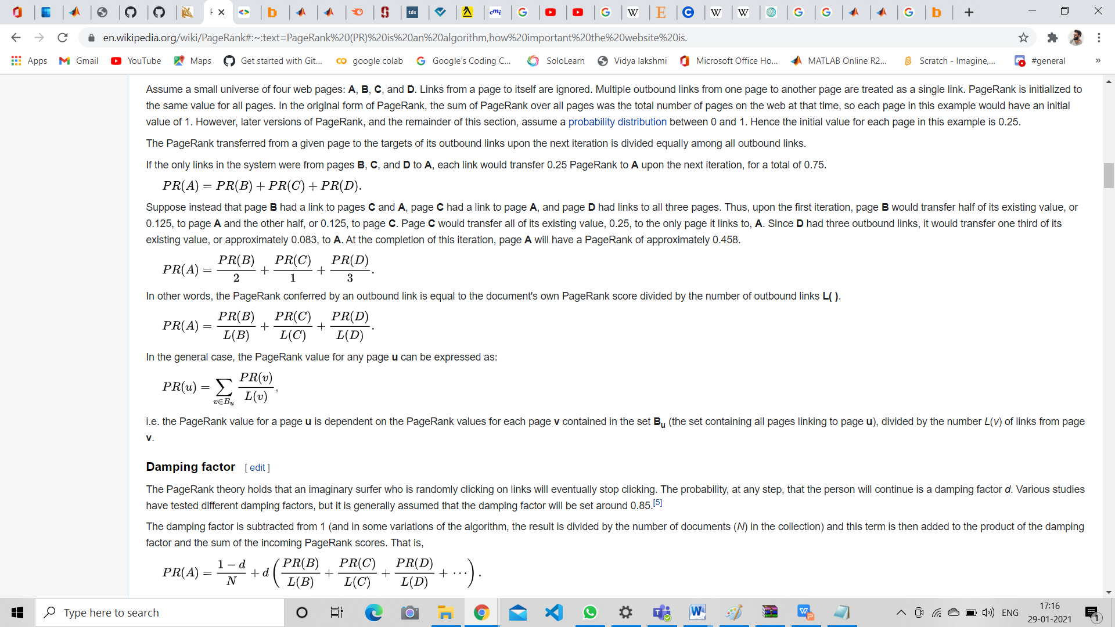
In other words, the PageRank conferred by an outbound link is equal to the document's PageRank score divided by the number of outbound links L( ).
In the general case, the PageRank value for any page u can be expressed as:
The PageRank value for a page u is dependent on the PageRank values for each page v contained in the set B_{u} (the set containing all pages linking to page u), divided by the number L(v) of links from page v.

Slide 20

Damping Factor
The PageRank theory holds that an imaginary surfer who is randomly clicking on links will eventually stop clicking. The probability, at any step, that the person will continue is a damping factor d. Various studies have tested different damping factors, but it is generally assumed that the damping factor will be set around 0.85.
The damping factor is subtracted from 1 (and in some variations of the algorithm, the result is divided by the number of documents (N) in the collection) and this term is then added to the product of the damping factor and the sum of the incoming PageRank scores. That is,

Slide 21

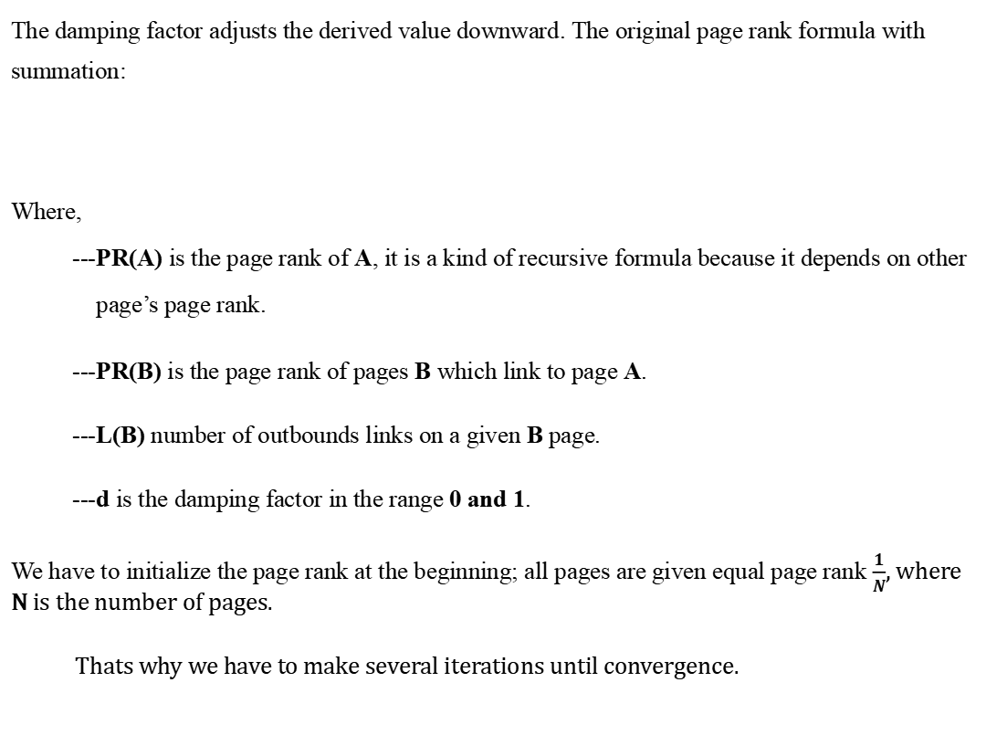
The damping factor adjusts the derived value downward. The original page rank formula with summation:
Where,
---PR(A) is the page rank of A, it is a kind of recursive formula because it depends on other
page’s page rank.
---PR(B) is the page rank of pages B which link to page A.
---L(B) number of outbounds links on a given B page.
---d is the damping factor in the range 0 and 1.
We have to initialize the page rank at the beginning; all pages are given equal page rank $\frac{1}{N}$, where N is the number of pages.
Thats why we have to make several iterations until convergence.

Slide 22

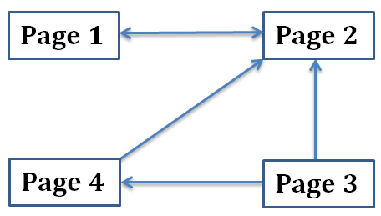

The iterative formula:
The WWW hyperlink forms a huge directed graph where the nodes represent web pages + directed edges are the hyperlinks.

Slide 23
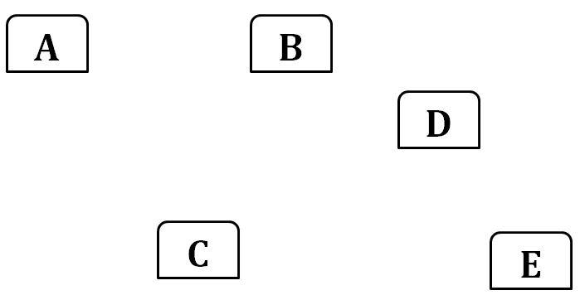
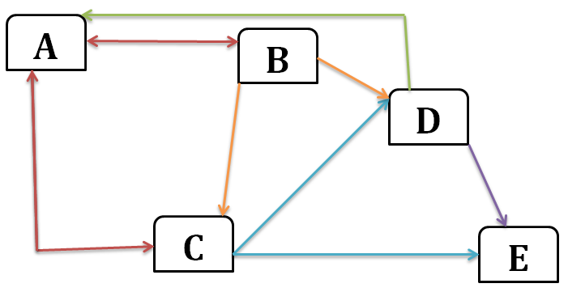
Example
1. Start with a set of pages.
2. Crawl the web to determine the link structure.

Slide 24
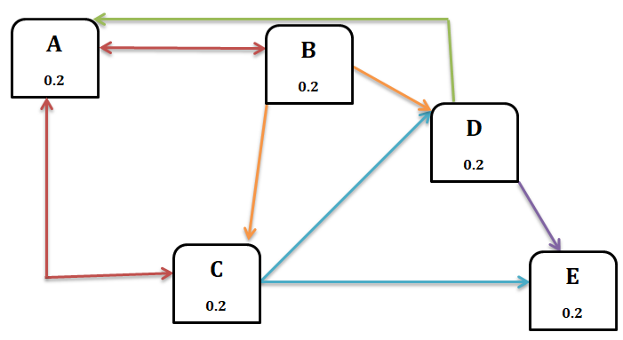
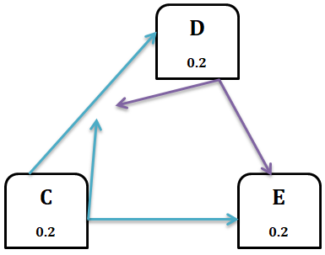

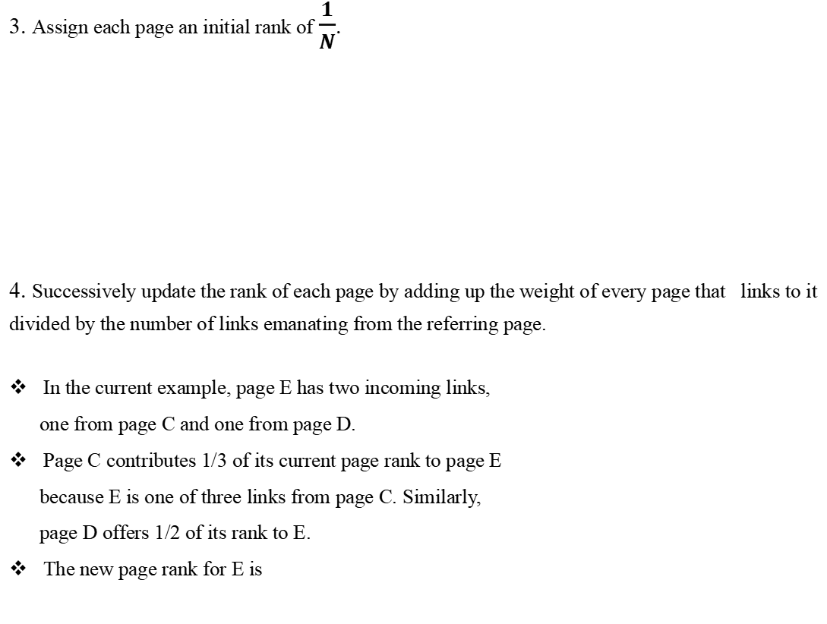
3. Assign each page an initial rank of $\frac{1}{N}$.
4. Successively update the rank of each page by adding up the weight of every page that links to it divided by the number of links emanating from the referring page.
In the current example, page E has two incoming links,
one from page C and one from page D.
Page C contributes 1/3 of its current page rank to page E
because E is one of three links from page C. Similarly,
page D offers 1/2 of its rank to E.
The new page rank for E is

Slide 25
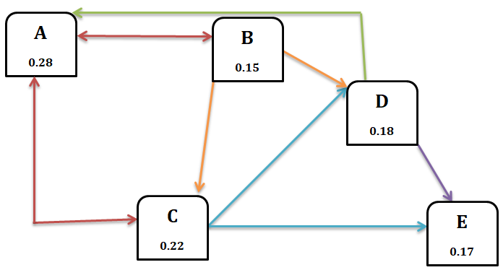
5. If a page (such as E in the current example) has no outward links, redistribute its rank equally among the other pages in the graph.
In this graph, 1/4 of E’s page rank is distributed to pages A, B, C, and D.
The idea behind this model is that users will keep searching if they reach a dead end.
6. Apply this redistribution to every page in the graph.

Slide 26
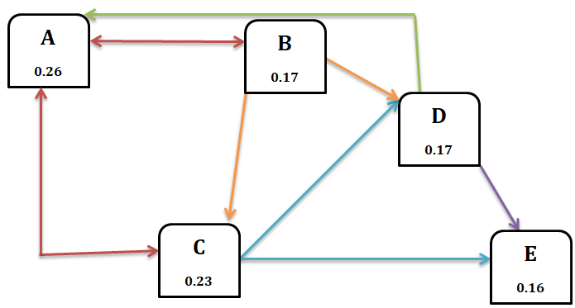
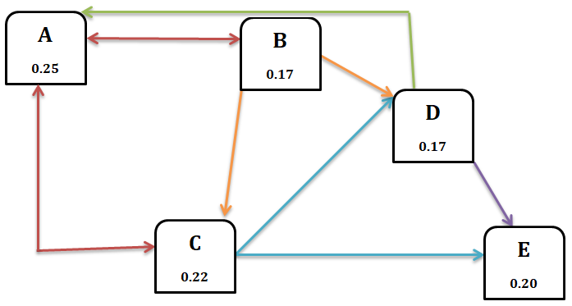
7. Repeat this process until the page ranks stabilize.
8. In practice, the Page Rank algorithm adds a damping factor at each stage to model the fact that users stop searching.

Slide 27
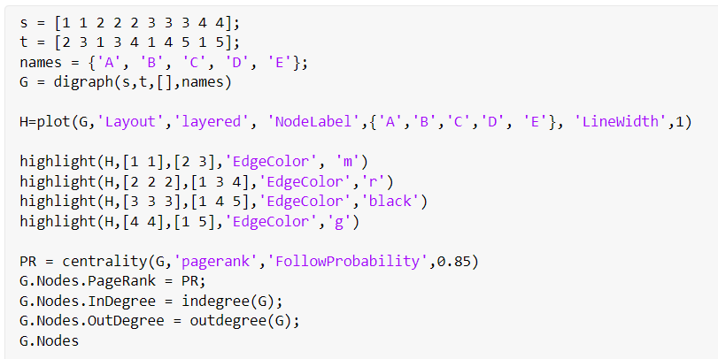
Implementation

Slide 28
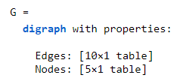
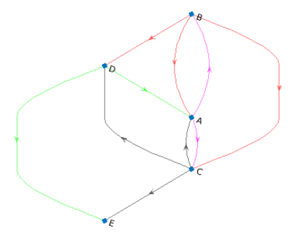
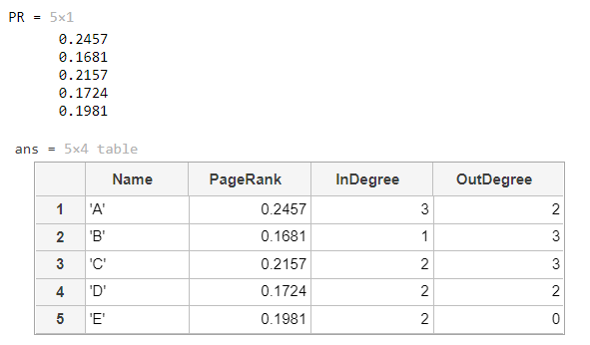

Slide 29

How does Google PageRank work?
Google takes into account three factors when calculating the PageRank of a web page, which are:
The quantity and quality of inbound linking pages;
The number of outbound links on each linking page;
The PageRank of each linking page.

Slide 30
Advantages and Disadvantages
Advantages:
---The algorithm is robust against Spam since its not easy for a webpage owner to add inlinks to his page from other important pages.
---PageRank is a global measure and is query independent.
---PageRank gives the information very efficiently according to the top most ranking of the webpage.
Disadvantages:
---The main disadvantage is that it favors older pages, because a new page, even a very good one, will not have many links unless it is part of an existing website.
---Relevancy of the resultant pages to the user query isvery less as it does not consider the content of web page.

Slide 31
---Other problems exists in the form of Dangling links which occurs when a page contains a link such that the hypertext points to a page with no outgoing links.
---It leads to Rank sinks problem occurs when in a network pages get in infinite link cycles.
---Dead Ends are possible ie., pages with no outgoing links.
---Another problem in PageRank is Spider Traps. A group of pages is a spider trap if there are no links from within the group to outside the group.
---If you have circle references in your website, then it will reduce your front page’s PageRank.

Slide 32
Conclusion
PageRank is a global ranking of all web pages based on their locations in the web graph structure
PageRank uses information which is external to the web pages – backlinks
Backlinks from important pages are more significant than backlinks from average pages.
The structure of the web graph is very useful for information retrieval tasks.

Slide 33

THANK YOU

